Slide 1

REACT JS
Revathi KS

Slide 2






What is React
Open-source Front end JavaScript library which is used for building user interfaces specifically for single page applications
Handling view layer for web and mobile apps
Allows us to create reusable UI components
Allows developers to create large web applications which can change data, without reloading the page
Developed by Facebook.

Slide 3
React JS Features
Virtual Dom
Reusable Component
Unidirectional data flow
Debugging
SEO
Easy Learning

Slide 4
ECMA SCRIPT – ES 6
let
const
Arrow Functions
Classes
Template String
ECMAScript is a Standard for a scripting languages.
ActionScript, JavaScript, JScript are based on the ECMAScript standard.

Slide 5
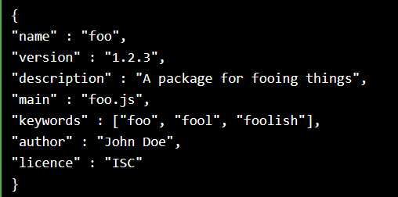

React Environment Requirement
Node Package Manager
npm install -g create-react-app
create-react-app myreactapp
cd/myreactapp
npm start
http://localhost:3030/
NPM is a software Package Manager and Installer
Install npm by installing Node.js
All npm packages are defined in files called package.json.

Slide 6
Take look on items…
JSX
Components
Props
State
Routing
Life Cycle

Slide 7
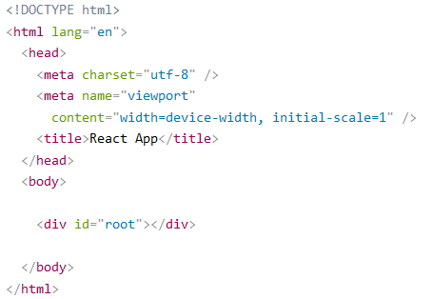
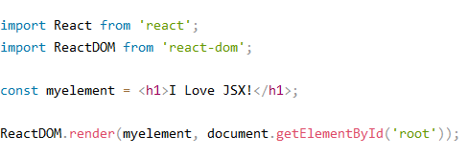

React - JSX
Stands for JavaScript XML/HTML
Write HTML elements in JavaScript and place them in the DOM without any createElement() and/or appendChild() methods.
JSX converts HTML tags into react elements.

Slide 8
REACT -components
A Component is one of the core building blocks of React.
Application will develop in React will be made up of pieces called components.
Functional Components
Class Components

Slide 9
REACT –components …
cl
Functional Components
Class Components
Stateless component.
Functional components are simply javascript functions. We can create a functional component in React by writing a javascript function. These functions may or may not receive data as parameters,
function Democomponent()
{
return <h1>Welcome Message!</h1>;
}
State full Component
We can pass data from one class component to other class component. We can use ES6 classes to create class based components in React.
class Democomponent extends React.Component
{
render(){
return <h1>Welcome Message!</h1>;
}
}

Slide 10
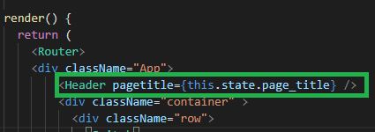
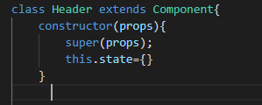
React Props
Pass information to a Component using props (stands for properties).
Props are basically kind of global variable or object.
If your component has a constructor function, the props should always be passed to the constructor and also to the React.Component via the super() method.

Slide 11
React states

Slide 12
React routing

Slide 13
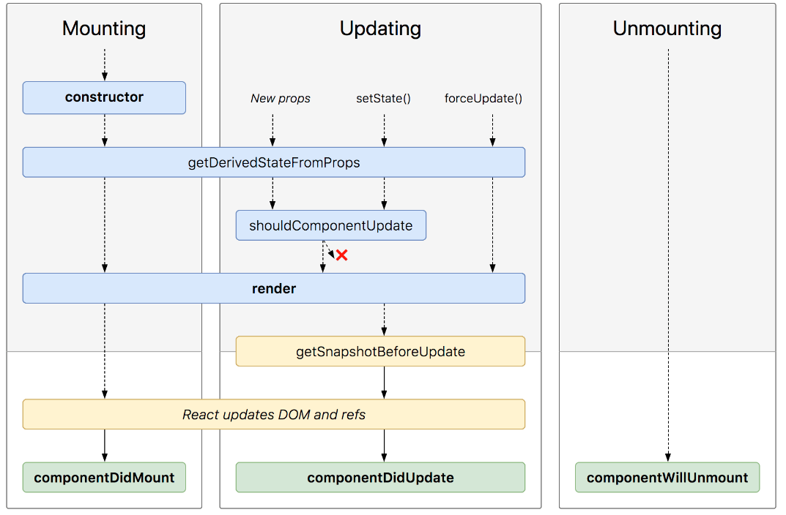
React life cycle

Slide 14




React session storage
localStorage vs sessionStorage
In sessionStorage the data is persisted only until the window or tab is closed
In LocalStorage the data is persisted until the user manually clears the browser cache or until your web app clears the data
localStorage and sessionStorage, part of the web storage API, to save key/value pairs locally
Advantages compared to using cookies:
The data is saved locally only and can’t be read by the server.
It allows for much more data to be saved (10Mb for most browsers).

